Slide 1
IBM Data Science Professional Certificate
Opening an Indian Restaurant in Calgary

Slide 2
CONTENTS
Introduction to business problem
Data sources
Exploring data set
Cleaning data and creating new data frame
Methodology
Observations
Results
Conclusion & future developments

Slide 3
INTRODUCTION TO BUSINESS PROBLEM
Calgary, is one of the Canadian cosmopolitan cities famous for its status as the centre of Canada’s oil industry. It is a home for opportunities.
The aim of this capstone project is to analyze the data of various neighborhoods in Calgary and determine best locations to set up a new business "Indian Restaurants".
This project would assist the investors and stakeholders to determine their industry for future investments.

Slide 4
DATA SOURCES
1. Calgary Wikipedia : https://en.wikipedia.org/wiki/Calgary
This data is used in listing the existing neighborhoods.
2. Open data- City of Calgary : https://data.calgary.ca/browse?tags=open+data
This site is used in obtaining new neighborhoods and their communities.
3. Foursquare API : https://foursquare.com/
Foursquare API is used to obtain latitude, longitudes and venue data for the different neighborhoods

Slide 5
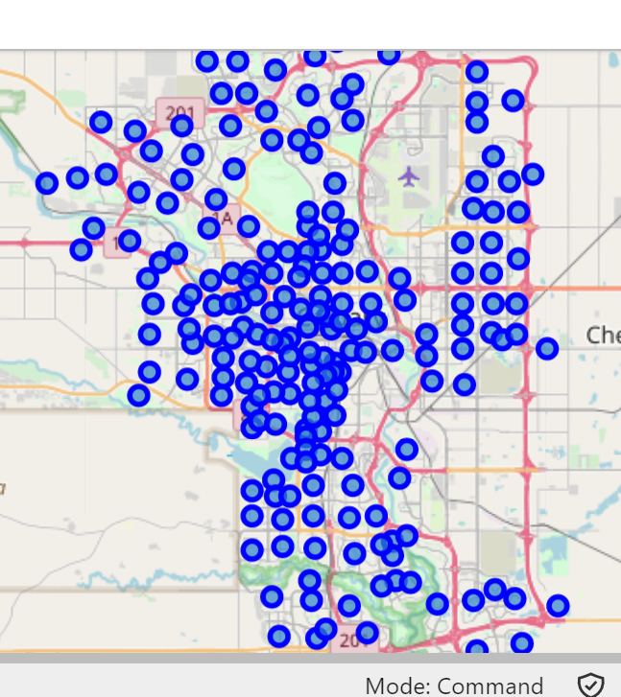
Exploring Data Set
Calgary dataset:
The data frame has 8 sectors and 213 neighborhoods.
Using Four Square API to obtain latitude, longitude and
venue information for Calgary

Slide 6
CLEANING DATA AND CREATING NEW DATA FRAME
There are 260 uniques categories.
Extracting venue data for all the neighborhoods of
Calgary within a radius of 1000 and limit of 100.
There are 260 unique categories of venues(businesses).
Creating new data frame consisting of data related to
Indian Restaurant in each neighborhood.

Slide 7
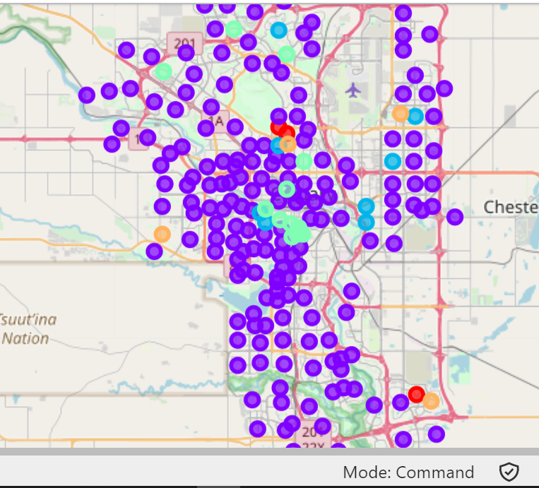
METHODOLOGY
Clustering the neighborhoods in Calgary
Run k-means to cluster the neighborhoods in Calgary into 5 clusters.

Slide 8
OBSERVATIONS
Cluster 0 : This cluster 3 neighborhoods and has equal number of Indian restaurants.
Cluster 1 : It can be observed that about 179 neighborhoods in Calgary don't have a signification number of Indian restaurants. It is clear that starting a new Indian restaurant in these neighborhoods is a good options for new investors.
Cluster 2 : This cluster 9 neighborhoods and has Indian restaurants.
Cluster 3 : This cluster 12 neighborhoods and has Indian restaurants.
Cluster 4 : This cluster 4 neighborhoods and Indian restaurants are present in these neighbourhoods.

Slide 9
RESULTS
Neighborhoods in Calgary that can become a potential area to start new Indian Restaurants.
Data shows that
40 neighborhoods in Central Calgary
25 in the West
8 in the East
16 in the North
38 in the South
9 southeast
23 northwest
18 northeast
for starting new Indian restaurant.

Slide 10
CONCLUSION & FUTURE DEVELOPMENTS
Data shows that about 178 neighborhoods in Calgary have a potential to launch new Indian Restaurants and improve the economy.
This dataset can be combined with dataset consisting of immigrant information, employment and transportation to make more specific assumptions.

